Slide 1
About this lecture...
CPU organization
Basic CPU operations
Control signals for CPU operations

Slide 2
How is a program executed?
We know that a program is a sequence of instructions. In order to execute a program, for every instruction, we will have to
bring the instruction from main memory.
find out what operation has to be performed by the instruction
communicate with memory and other de­vices (if needed) to fetch data.
perform the operation
find out which is the next instruction to be executed
repeat the above steps for the next instruc­tion.

Slide 3
How does CPU execute an instruction?
CPU consists of several general purpose reg­isters, special purpose registers, control unit and ALU.
CPU brings the instruction from main memory to the Instruction Register in instruction fetch stage. To do so, the address of the memory location containing the instruction is available in the PC register.
After fetching an instruction, the PC is in­cremented to point to the next instruction to be executed.
A branch instruction modifies, if needed, the program counter after the execution of the current instruction.
For executing an arithmetic or logic oper­ation, the operands have to be supplied to the ALU.

Slide 4
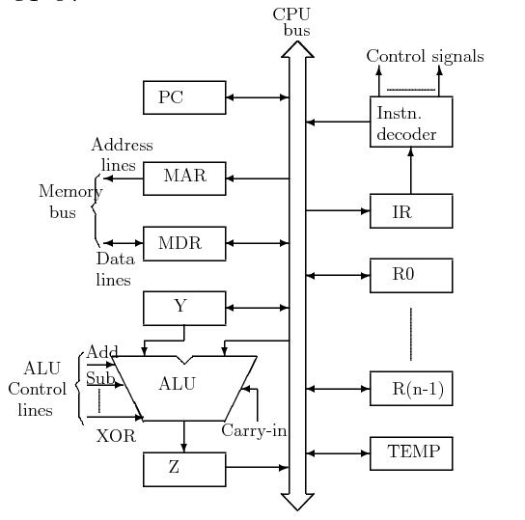
Organization of Central Processing Unit
There are various possible organizations of a CPU. The following figure shows an organization using a single internal bus for the CPU. Note the unidirectionality/bidirectionality of buses.

Slide 5
Single ­Bus Organization of CPU
MAR : Memory Address Register
MDR/MBR : Memory Data/Buffer Register
PC : Program Counter
IR : Instruction Register
R0-­R(n - 1) : General Purpose and Special Purpose Registers.

Slide 6
Y,Z, Temp : Registers transparent to the programmer, cannot be referenced directly in any instruction. Used only for the tem­porary storage during execution of instruc­tions.
All registers (except IR) and the ALU are used for data handling (storage and manip­ulation). These are collectively referred as Data Path.
Instruction Decoder and Instruction Regis­ter are integral part of the control cir­cuitry in the CPU, referred to as Control Path.

Slide 7
Basic CPU Operations
The complete execution cycle of an instruction (fetch, decode, execute) is performed by a sequence of some basic operations of data transfer and arithmetic and logic oper­ations. These basic operations are :
Fetching a word from memory
Storing a word in memory
Register transfers
Performing arithmetic or logic operations

Slide 8
Fetching a word from memory
In order to fetch a word from memory, the CPU has to load the MAR with the address of memory location.
Then it has to issue a read signal to memory.
After some time, memory responds with data which gets stored in MDR. This time depends on memory cycle time (will be discussed in more detail when discussing Memory System).

Slide 9
Storing a word in memory
As in the case of fetching a word, the address of memory location has to be put in MAR.
Data to be stored is loaded into MDR.
A write request is then sent to memory, and CPU waits for write to be over. (Why?)
CPU holds the address and data active till it is written in the memory. (Why?)

Slide 10
Timing consideration
Memory functions generally take much longer to complete than a CPU cycle.
In most of the cases, CPU will have to wait for the completion of the memory function before going to the next step.
However, it is possible to initiate the next CPU operation if the operation doesn't need MAR or MDR.

Slide 11
Register Transfer
One of the most common CPU operations.
The data is transferred from one register to another.
To do so, the data is to be put on CPU internal bus from the source register, and loaded in destination register.
Need to provide some type of control mech­anism to ensure that at any instance, at most one register is loading the data bus, al­though several registers can receive the data from the bus simultaneously.
This can be achieved by providing some con­trol signals (or gating signals) to activate a register output to the common bus and to activate a register input from the bus.

Slide 12
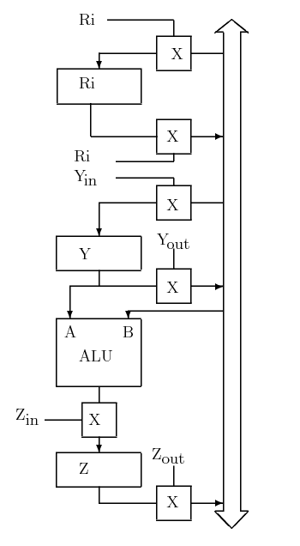
Input/Output Gating (X denotes a Gate)

Slide 13
Performing ALU Operation
For performing a binary ALU operation, one of the operands has to be loaded in the CPU internal register Y.
The other operand is gated on the common bus.
ALU is activated to perform the desired function.
After performing the needed operation, the ALU result is loaded in Z register.
Result is put on common bus and trans­ferred to another register.

Slide 14
Execution of an Instruction
Example of execution of a non­ branching in­struction:
ADD R1, [R2]
This instruction adds the contents of mem­ory location pointed by R2 to the contents of R1.
Steps of execution:
Fetch the instruction.
Fetch the first operand (contents of mem­ory location pointed by R2).
Put the contents of R2 in MAR, Issue Memory Read, Wait, Read/Transfer Contents of MDR
Perform the addition.
Put result in R1

Slide 15
Control Signals needed for execution
In order to carry out the above sequence of operations, the following sequence of control signals are needed to be generated. All con­trol signals in one line can be generated at a single time step.
PC out, MAR in, Read, Clear Y, Set Carry­_in to ALU, Add, Z in
Z out, PC in, WMFC (Wait for Memory Function to Complete)
MDR out, IR in
R2 out, MAR in, Read
R1 out, Y in, WMFC
MDR out, Add, Z in
Z out, R1 in

Slide 16
Execution of a branch instruction
Fetch phase is similar to non ­branching instruction.
After decoding instruction program counter is modified using offset field.
Example : Jump .+5000
Branch to the location 5000 away from the current instruction.

Slide 17
Control Signals
Control signals needed for the various steps in the execution of the above branch instruc­tion are:
PCout, MARin, Read, Clear Y, Set carry_­in to ALU, Add, Zin
Zout, PCin, WMFC
MDRout, IRin
Offset ­field­ of ­IRout, Add, Z in
Zout, PCin
Program counter will have the branch ad­dress.

